Slide 1
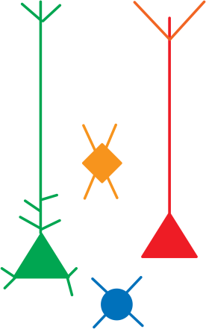
Organization of Thalamic and Callosal Synaptic Inputs to Projecting Neurons of the Auditory Cortex
(Alexander Flyax, Crystal Rock, Alfonso Apicella)
October 3, 2014

Slide 2
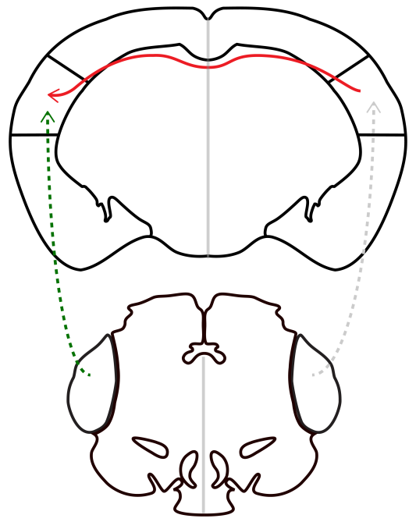
long-range inputs to auditory cortex

Slide 3
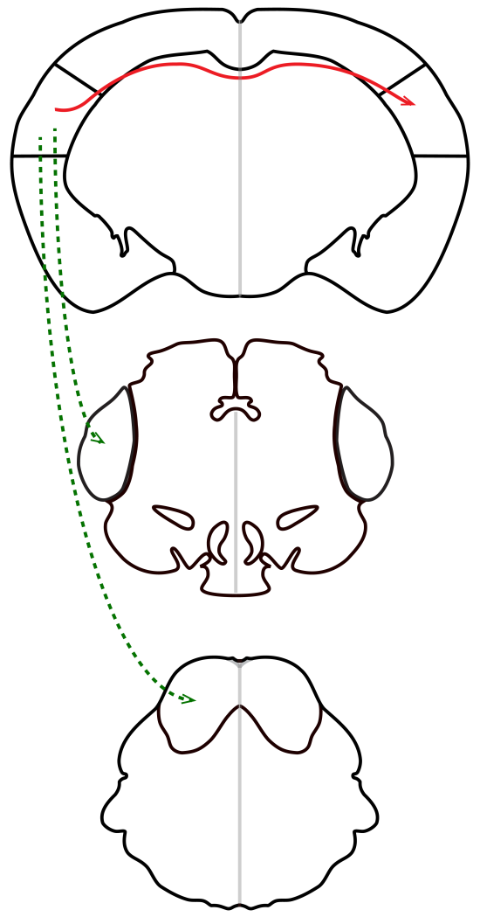
long-range inputs to auditory cortex
long-range outputs from auditory cortex
ACx
ACx
thalamus
thalamus
inferior colliculus

Slide 4
long-range inputs to auditory cortex
long-range outputs from auditory cortex
?

Slide 5
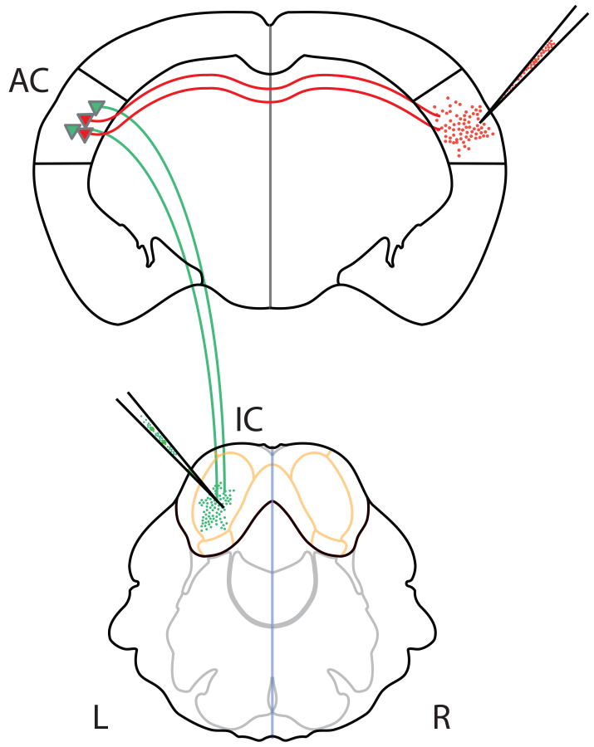

Slide 6
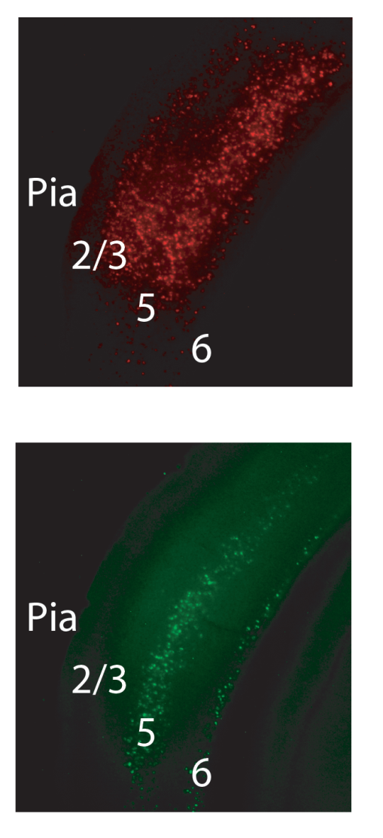
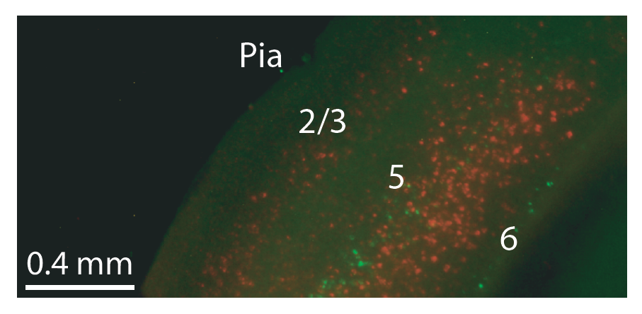

Slide 7
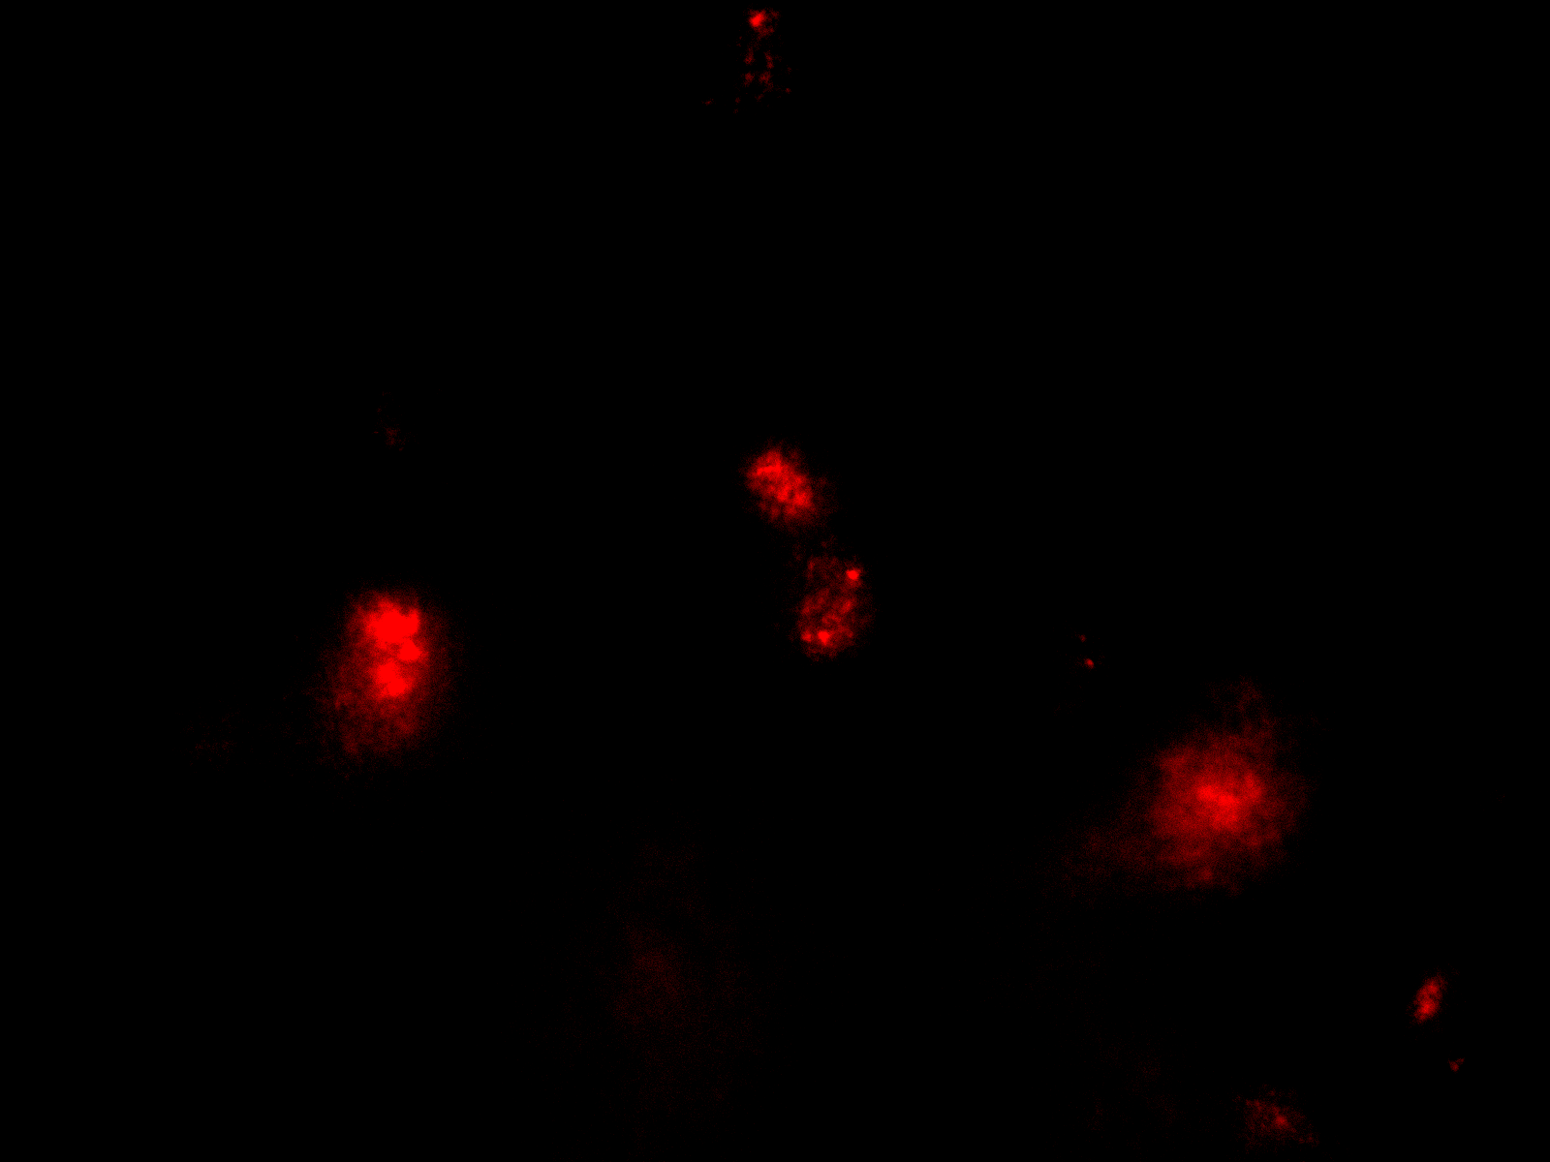

Slide 8
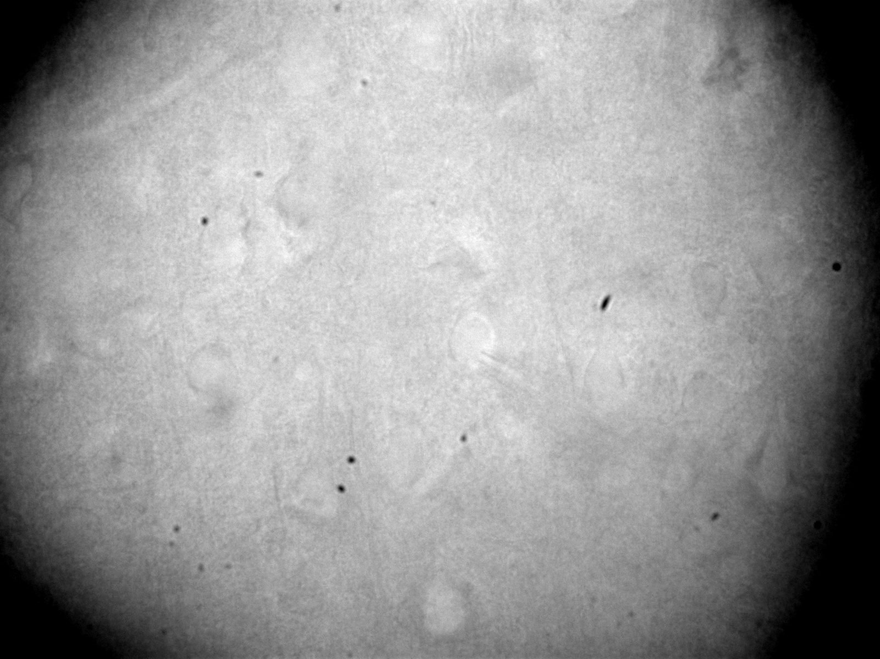

Slide 9
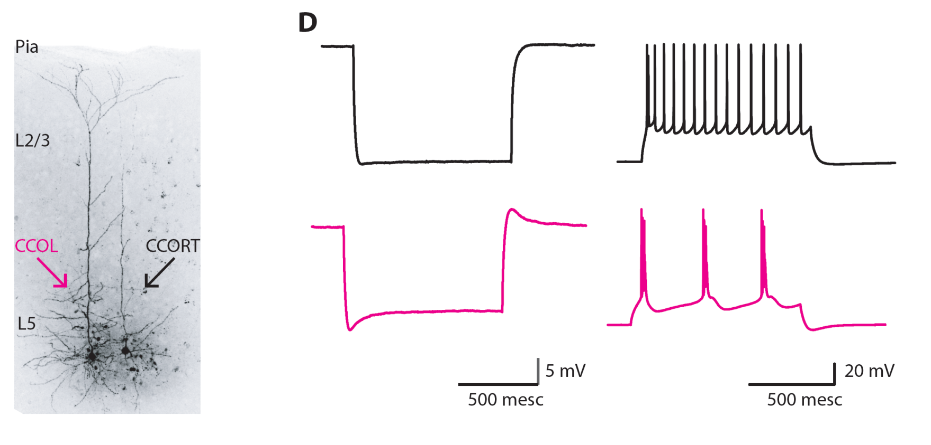

Slide 10
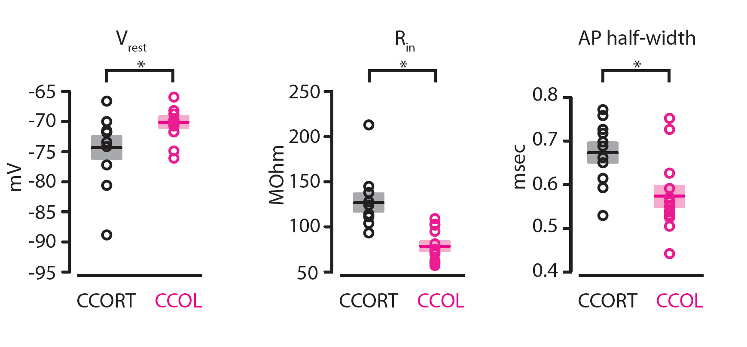

Slide 11
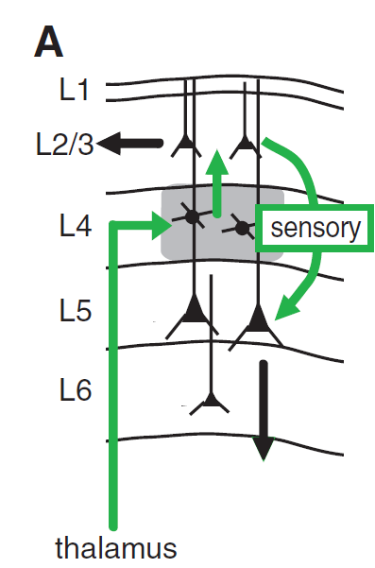
(Constantinople and Bruno, 2013)

Slide 12
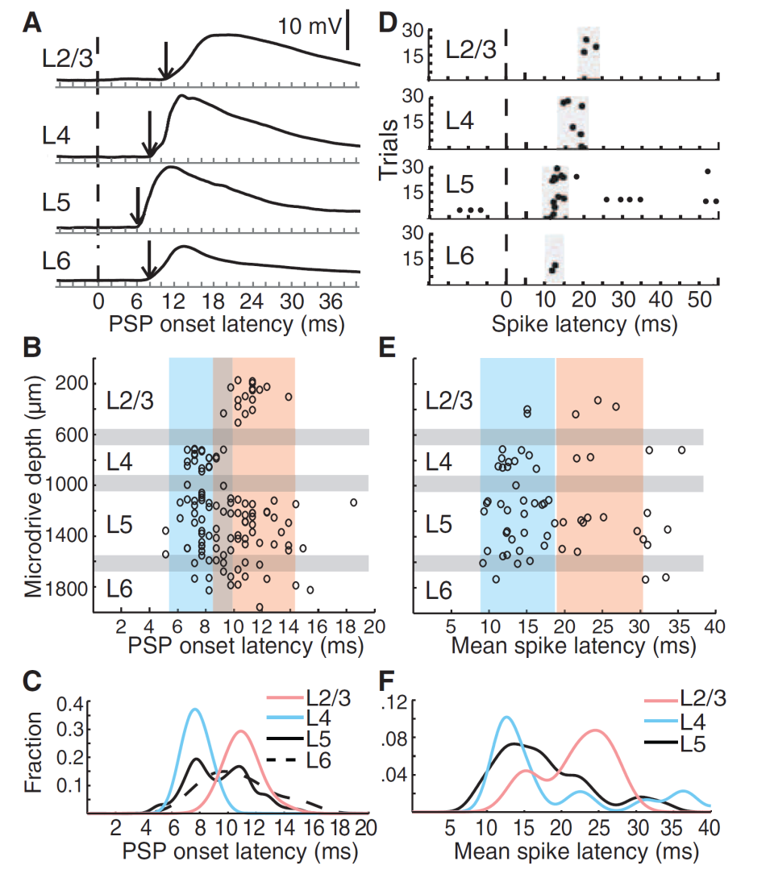
(Constantinople and Bruno, 2013)

Slide 13
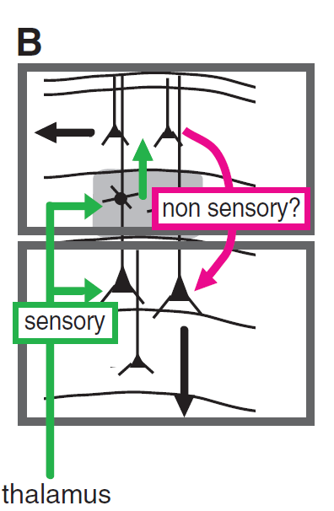
(Constantinople and Bruno, 2013)

Slide 14
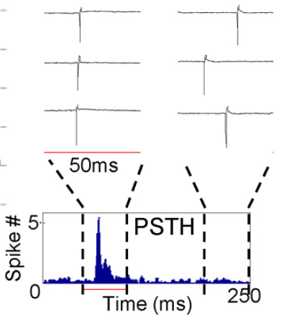
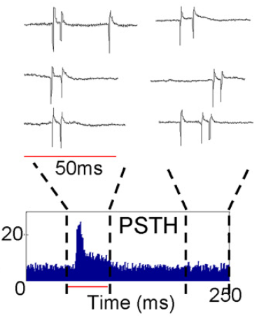
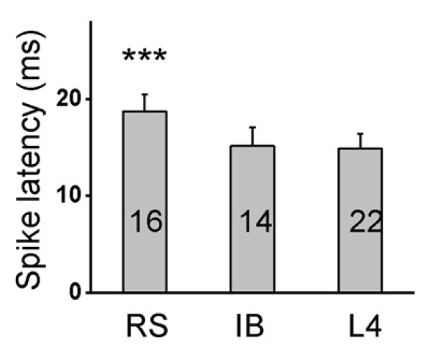
(Sun et al., 2013)
Notes:
*** cut out PSTHs and spike latency bars

Slide 15
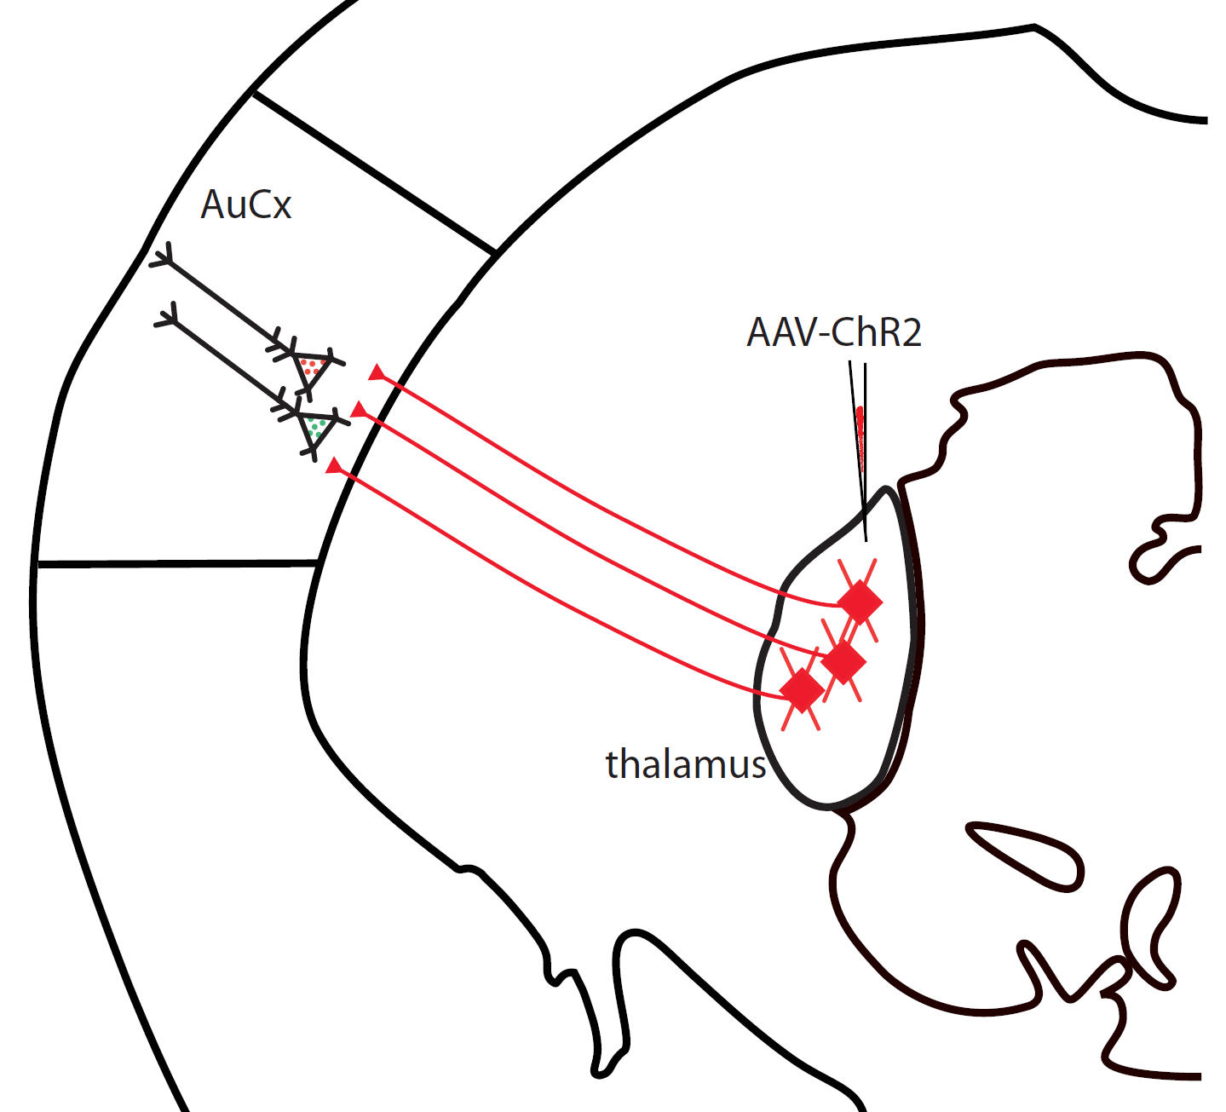

Slide 16
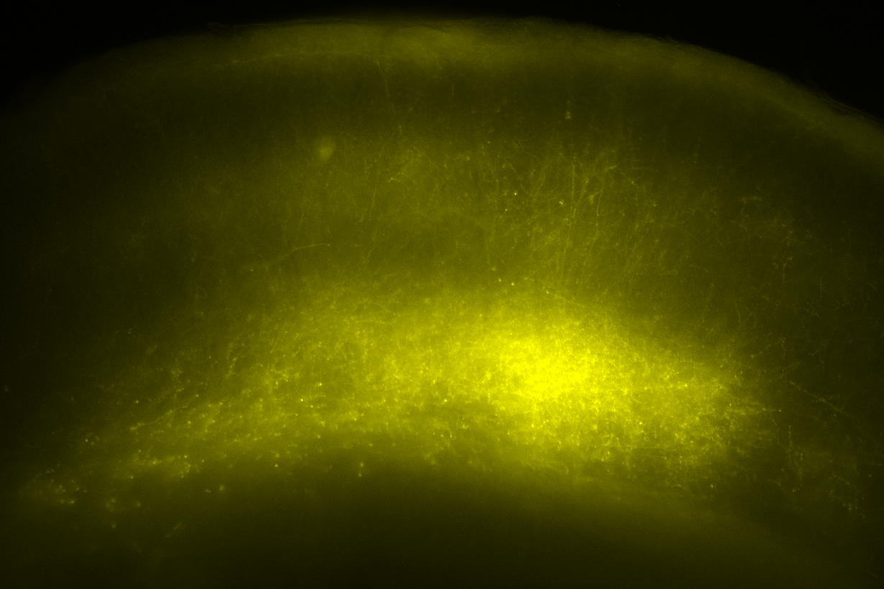
pia
L 2/3
L 4
L 5

Slide 17

TTX (1 µM)
4AP (100 µM)

Slide 18
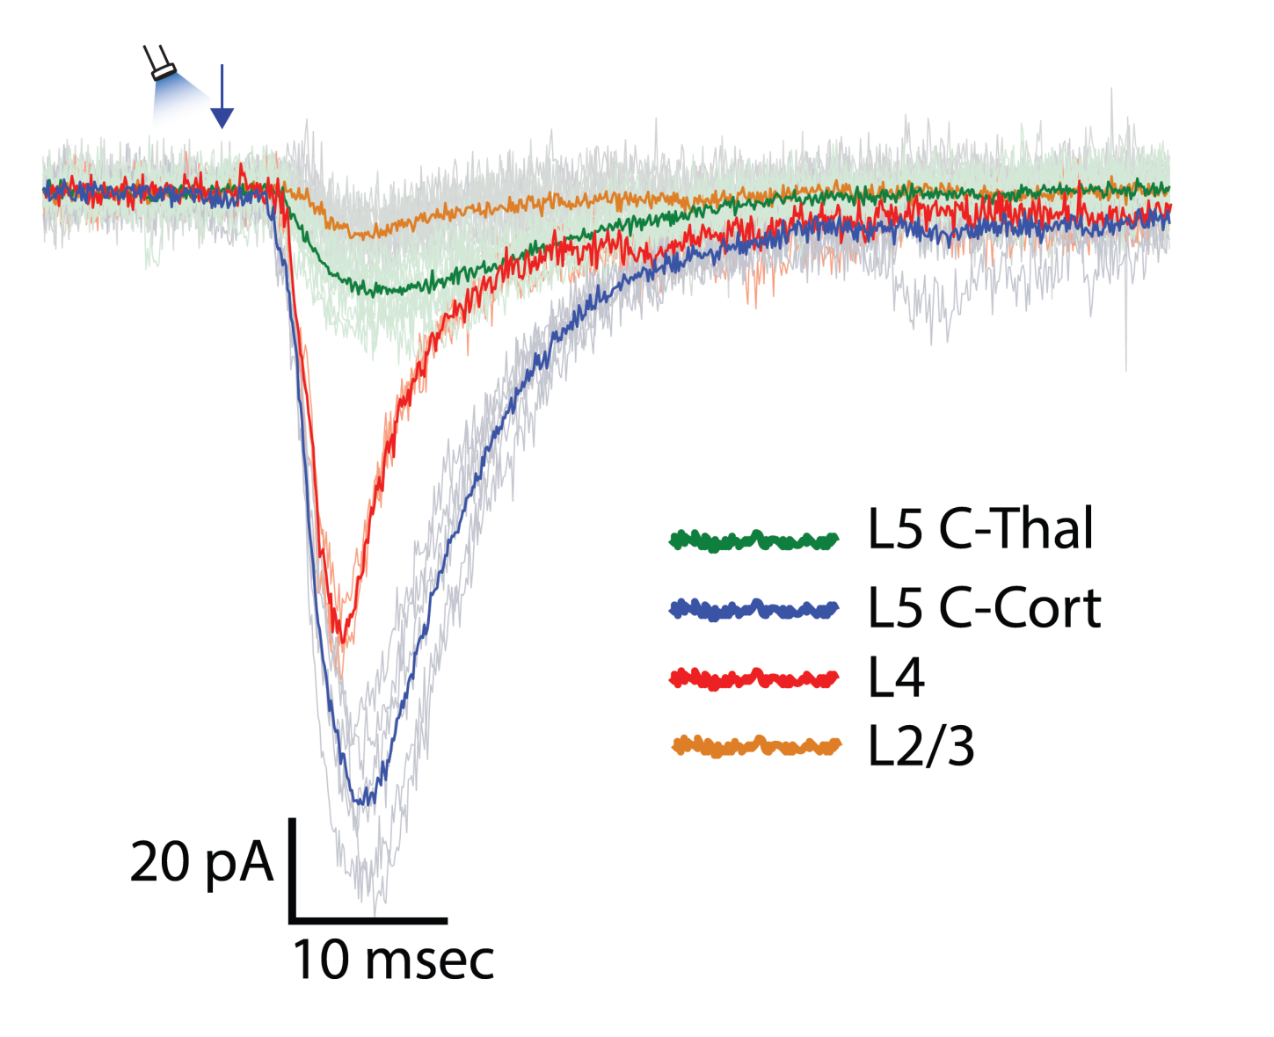
laminar profiling: thalamic input
TTX (1 µM)
4AP (100 µM)

Slide 19
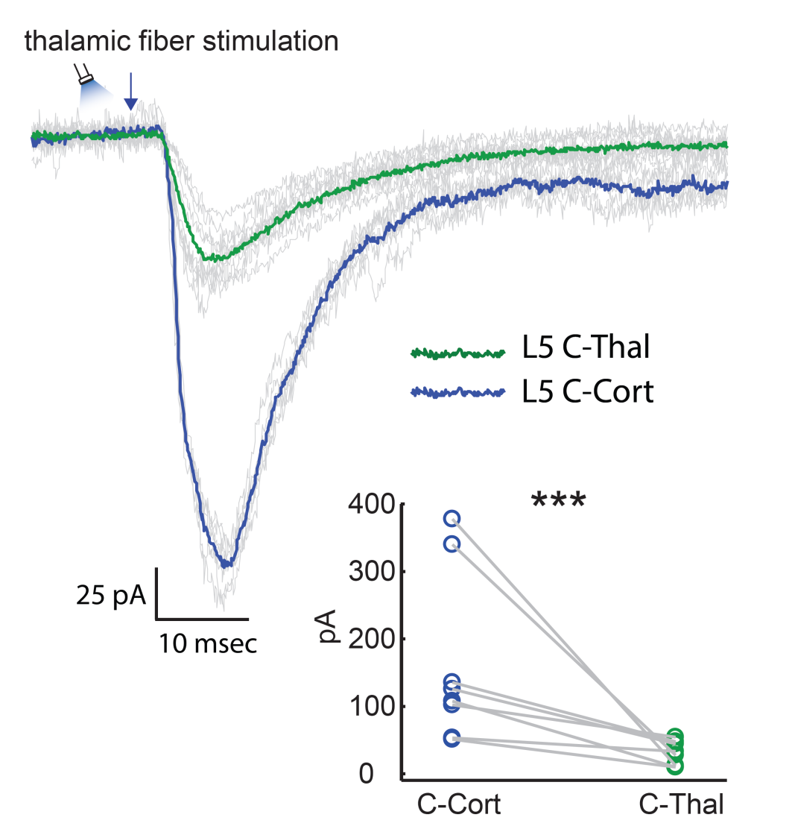
monosynaptic EPSCs
TTX (1 µM)
4AP (100 µM)

Slide 20
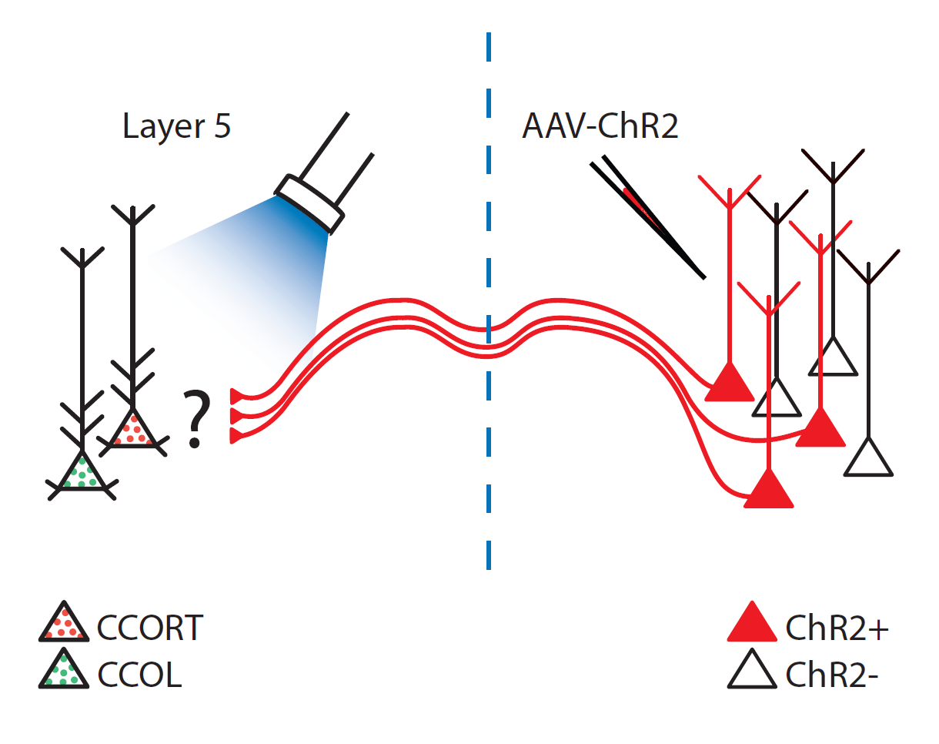
TTX (1 µM)
4AP (100 µM)

Slide 21
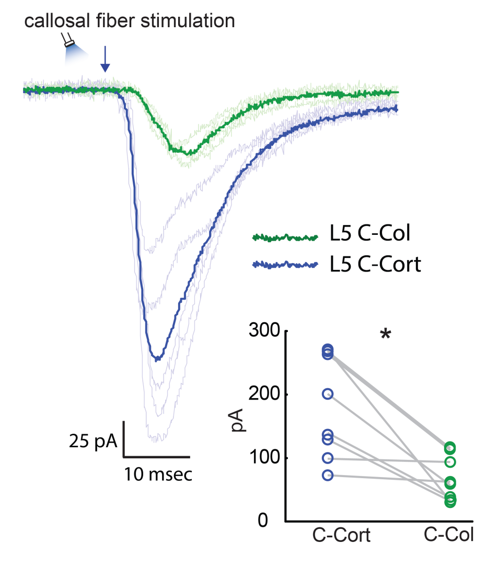
monosynaptic EPSCs
TTX (1 µM)
4AP (100 µM)

Slide 22
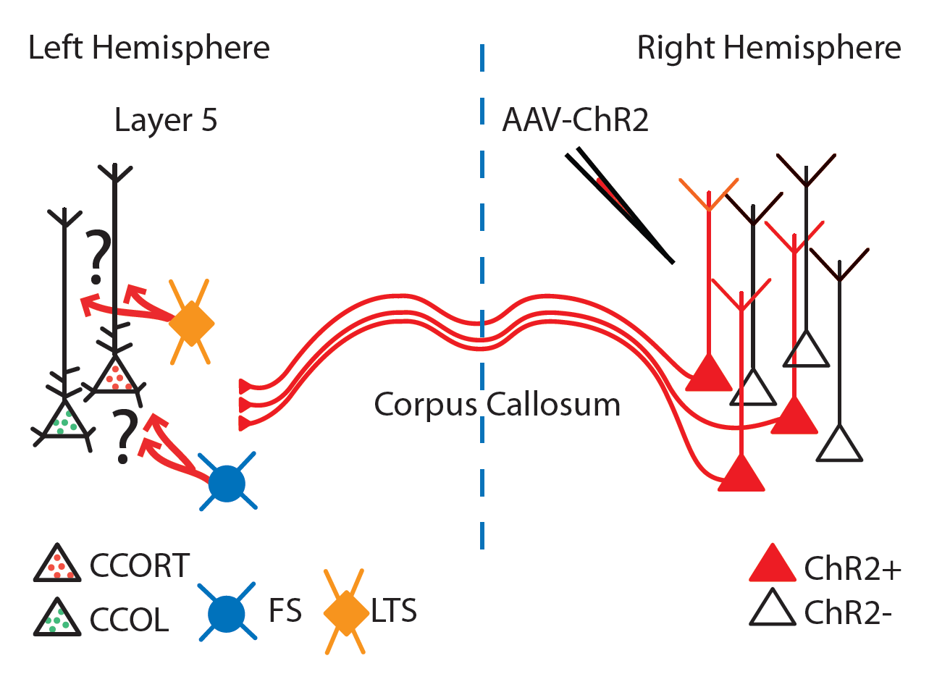

Slide 23
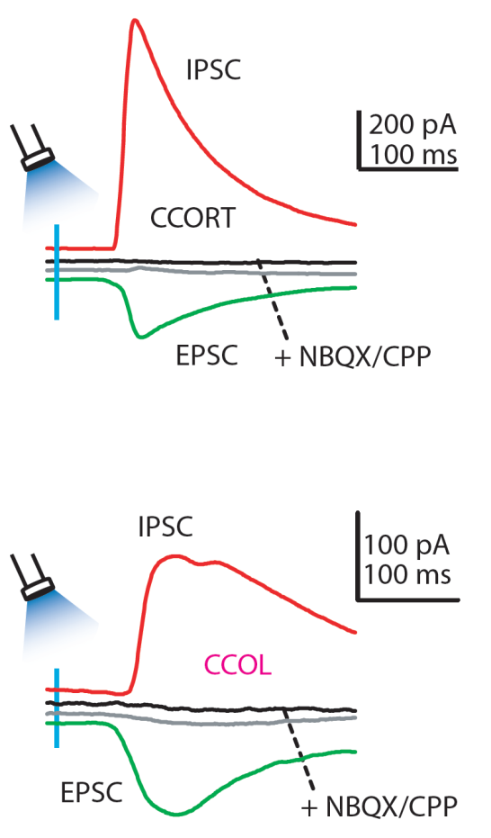

Slide 24
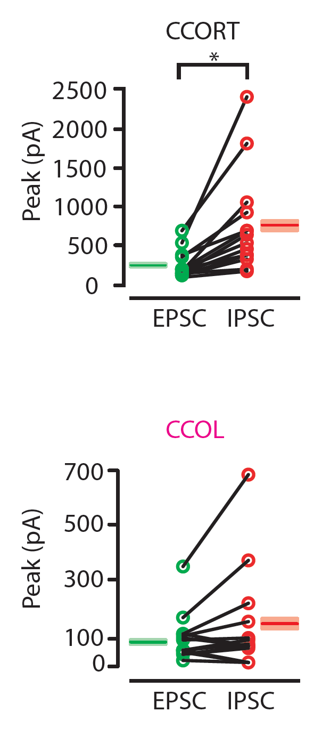

Slide 25
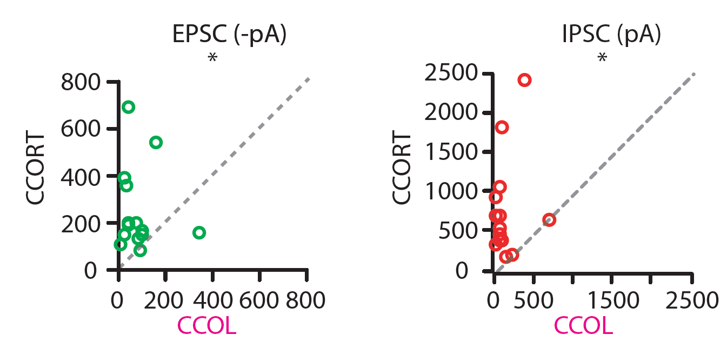
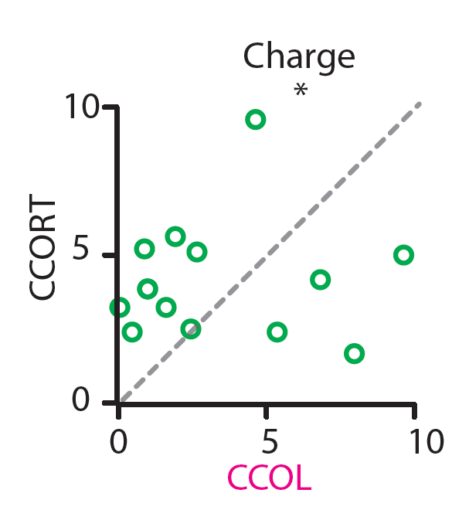
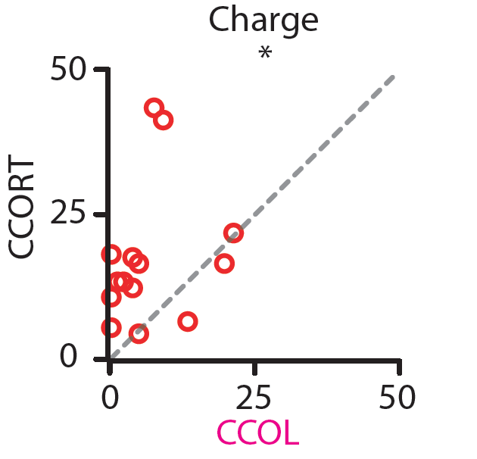

Slide 26
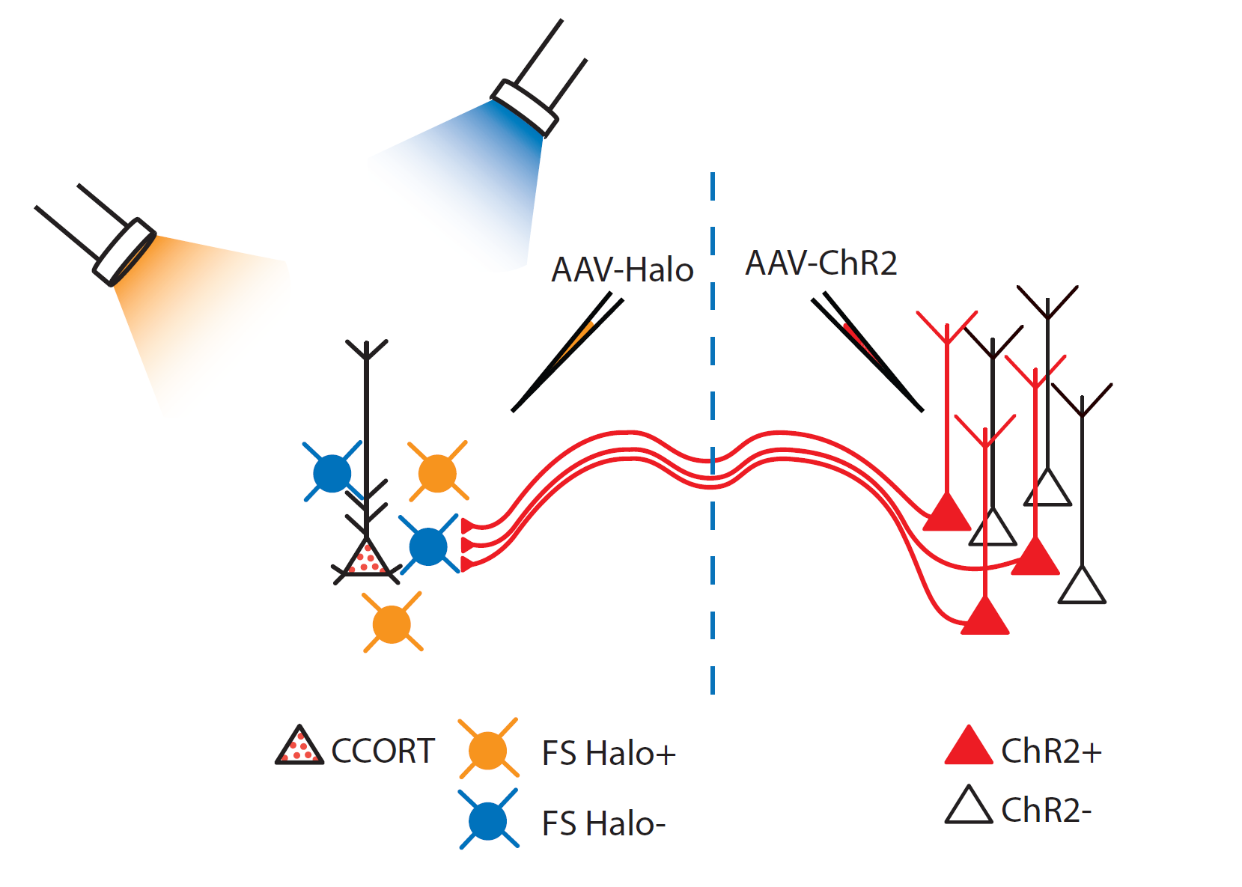

Slide 27
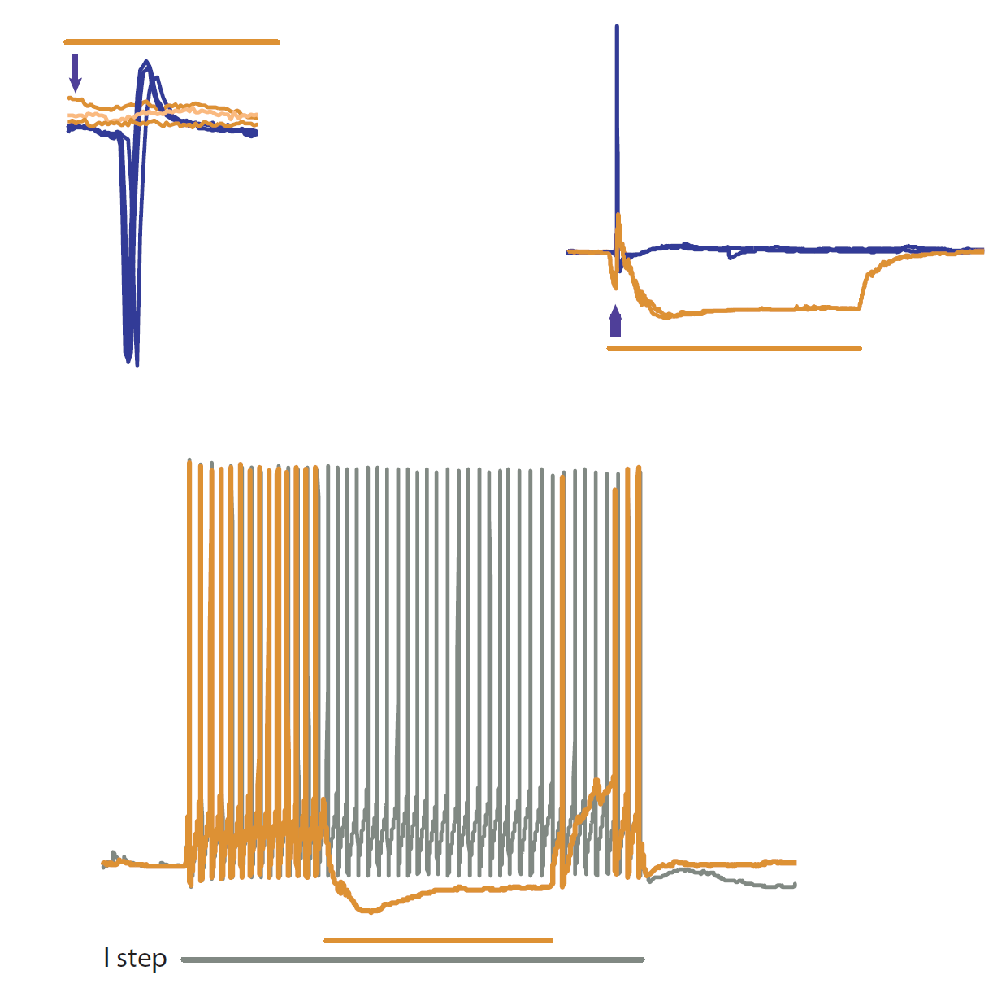


Slide 28
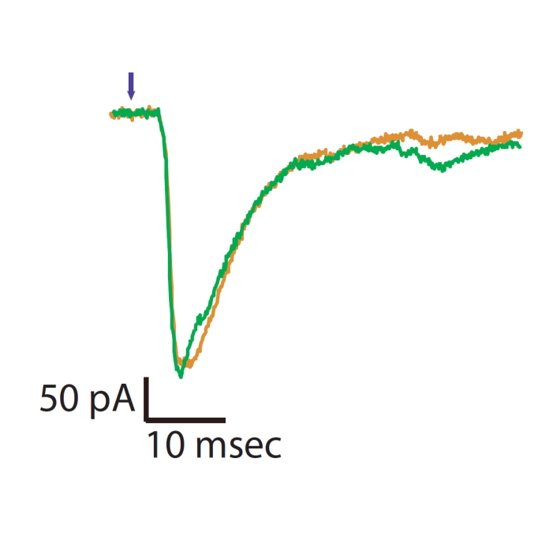
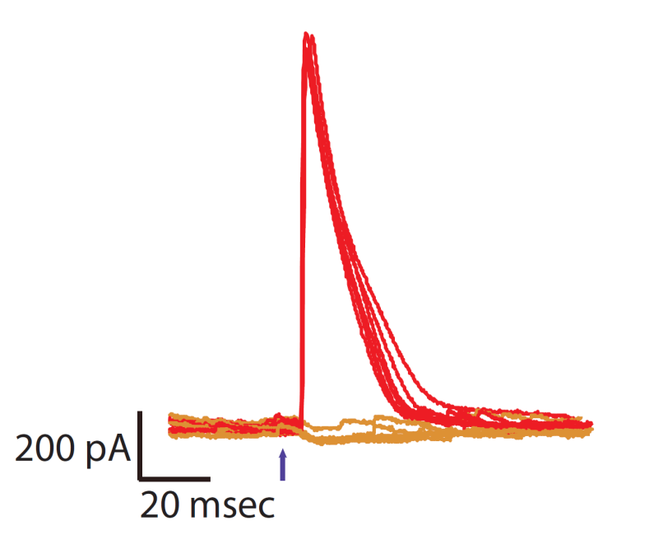
V_{hold} = –70 mV
V_{hold} = +10 mV

Slide 29
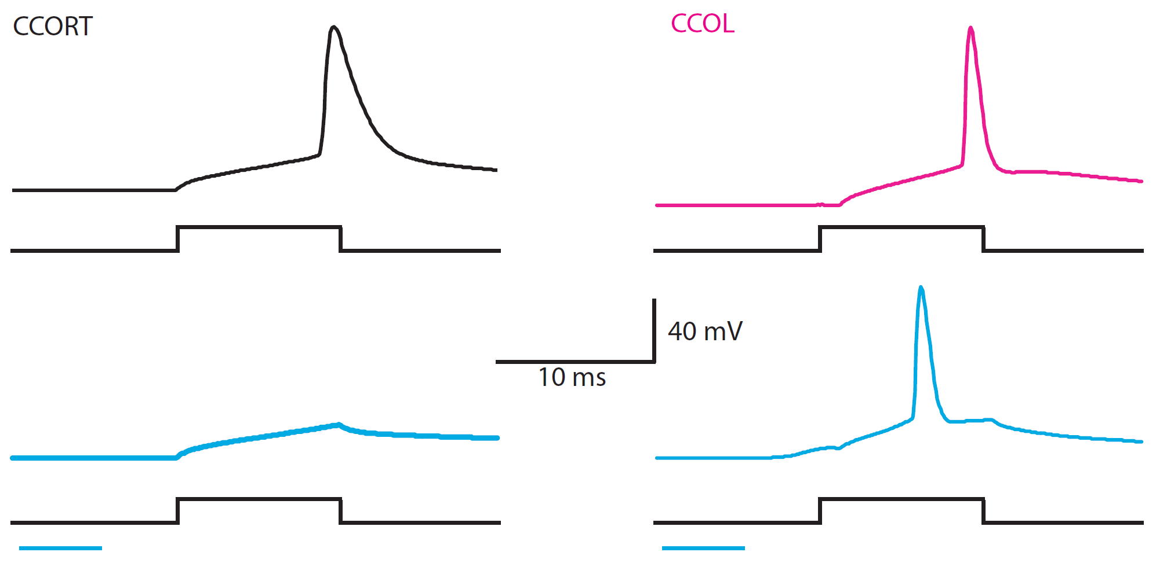

Slide 30
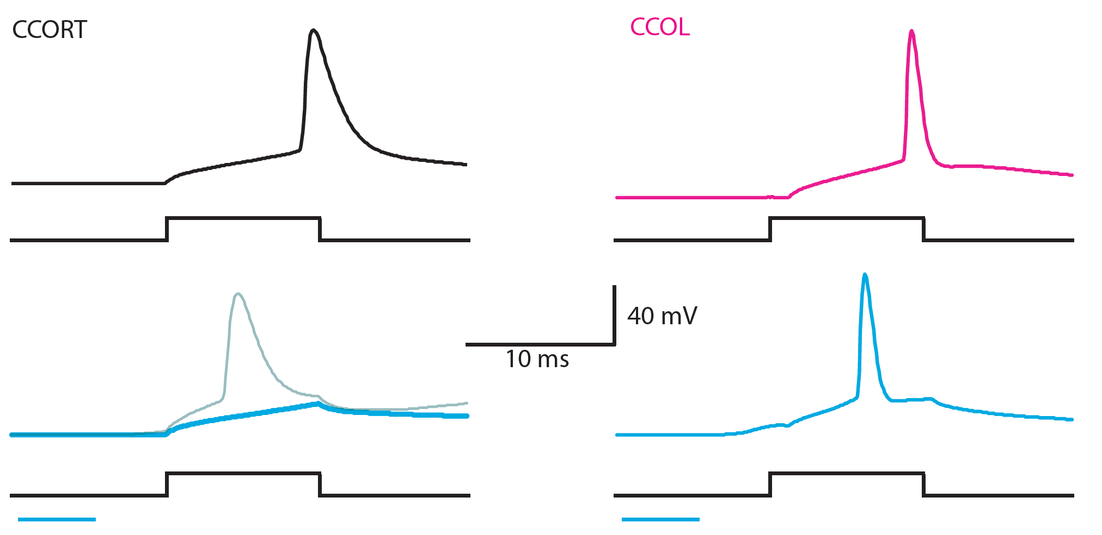
gabazine

Slide 31
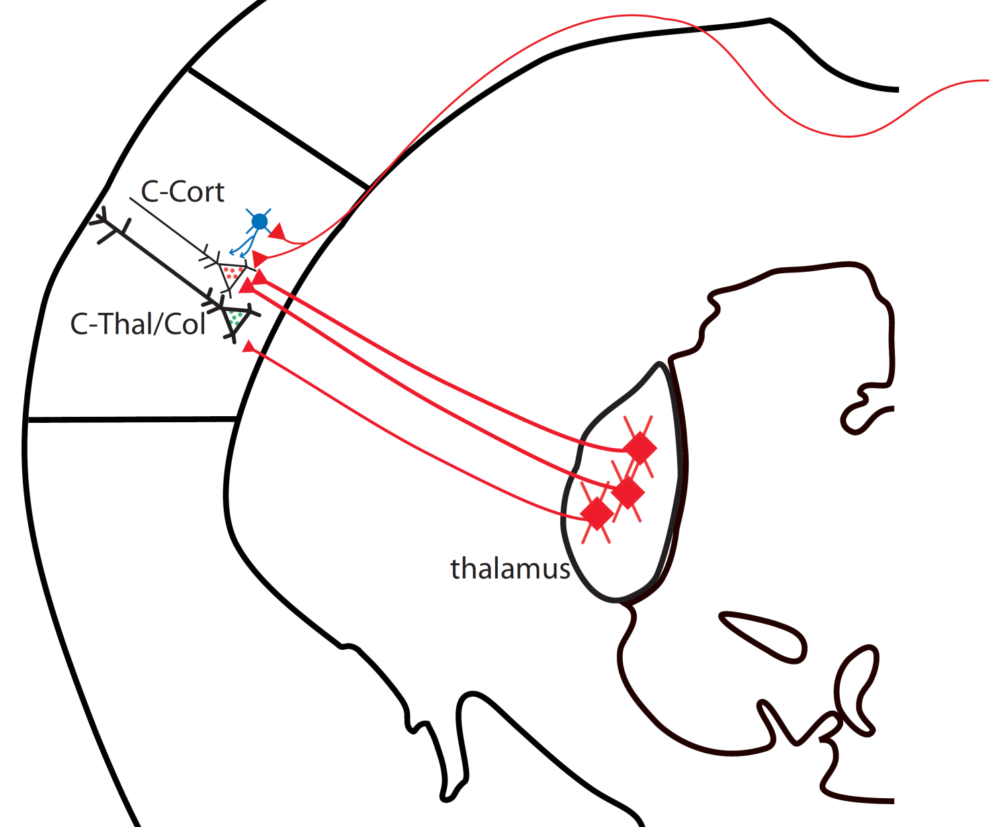
summary
FS

Slide 32
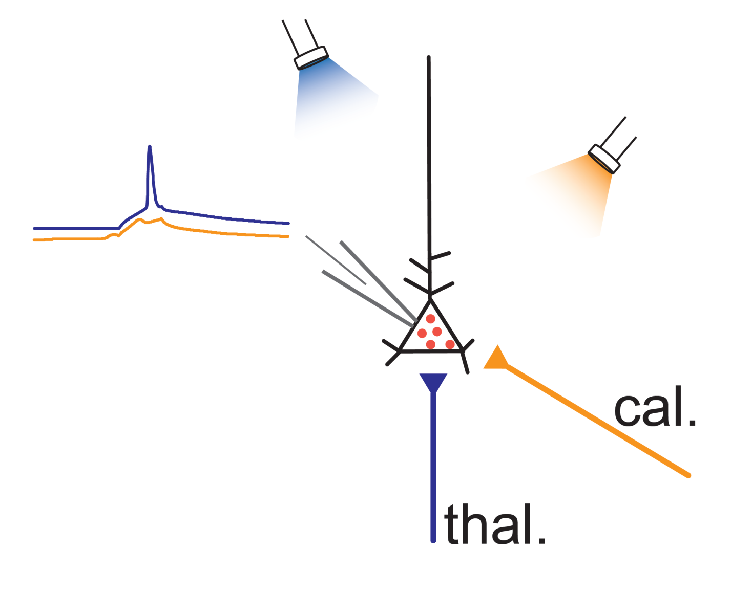
future directions
?

Slide 33
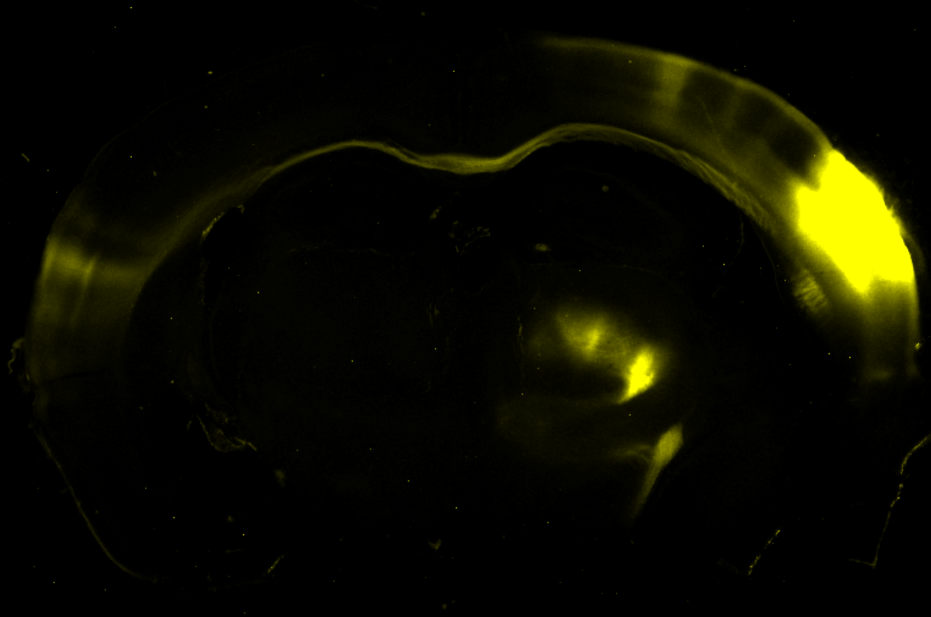

Slide 34
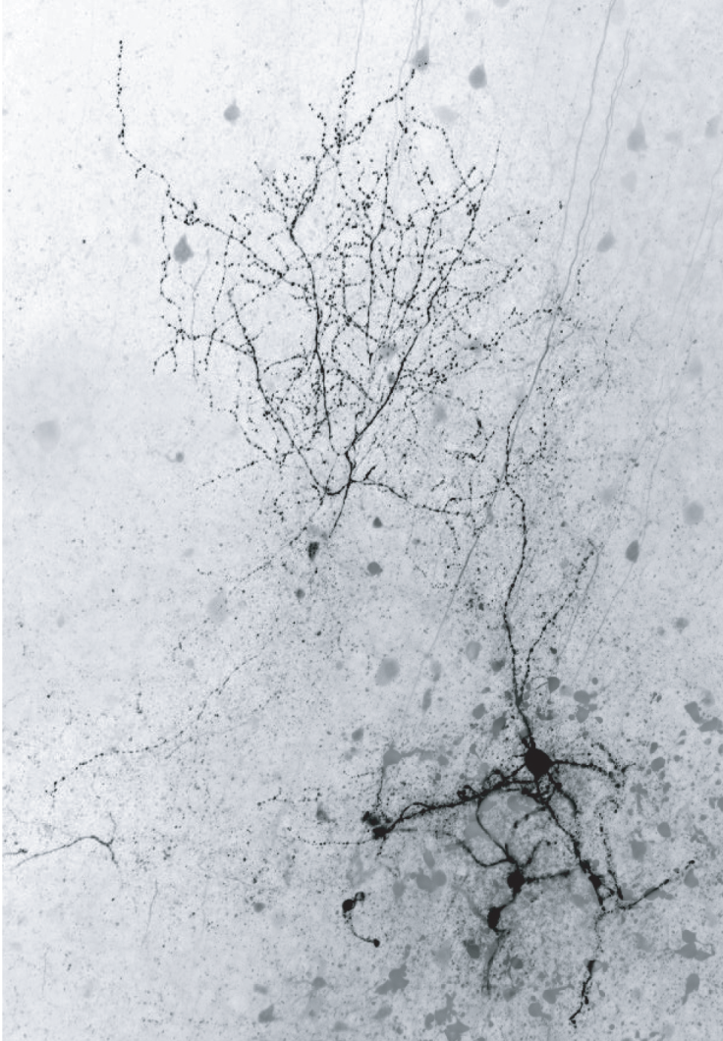
Acknowledgments
Alfonso Apicella
Crystal Rock
Alyssa Petko
Monique Villarreal
Chad Milam
Carlos Paladini
Charles Wilson
Sharmon Lebby
Gary Gaufo
Angela Huang

